Slide 1
Agenda
Apache Maven
Redis as caching layer
Spring Security Basics
JWT Authentication & Authorization
OAuth2 Flows And Roles
OpenID Connect With Identity Providers
Security Best Practices In Microservices
Dockerize Spring Boot applications
Docker Compose for multi-container apps
Kubernetes basics (pods, services, deployments)
Kubernetes Cluster
Helm, ConfigMaps, Secrets
Load balancing, health checks
Deployment Pattern
Logging & monitoring in Kubernetes

Slide 2
Apache Maven
Apache Maven
What is Apache Maven?
Why do we need Apache Maven?
How does Apache Maven work?
What are Maven build lifecycle phases?
What is a POM file in Maven?
What are the benefits of using Maven?
What tools or plugins does Maven support?

Slide 3
What is Apache Maven?
A build automation and project management tool used mainly for Java projects.
Manages project builds, documentation, and reporting from a single configuration (pom.xml).
Developed by Apache Software Foundation.

Slide 4
Why Do We Need Apache Maven?
Eliminates manual build scripting (like Ant).
Handles dependency management automatically.
Standardizes project structure.
Integrates easily with CI/CD tools like Jenkins and GitLab.

Slide 5
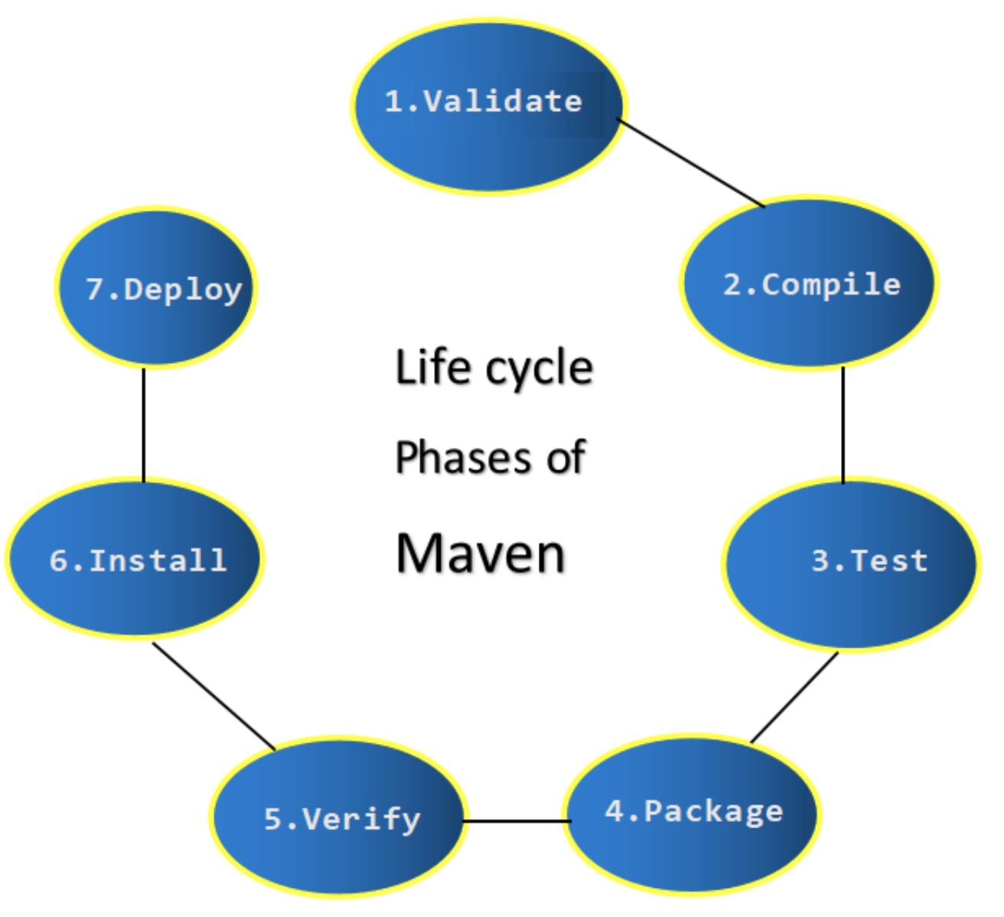
DevOps Lifecycle
Continuous Delivery
Notes:
Implement full stack monitoring, get actionable alerts and gain insights from logs and telemetry with Azure Monitor. Manage your cloud environment with Azure Automation and tools such as Ansible, Chef, or Puppet.
Keep provisioned infrastructure and applications in compliance with Azure Blueprints or Chef Automate. Used with Azure Security Center, you’ll limit threat exposure as well as find and remediate vulnerabilities quickly.

Slide 6
How Maven Works?
How Does Apache Maven Work?
Uses pom.xml (Project Object Model) file for configuration.
Downloads required dependencies from a central repository.
Executes tasks based on defined build phases (like compile, test, package).

Slide 7
Benefits & Plugins
What Are the Benefits of Using Maven?
Standardization across all Java projects.
Automatic dependency management
Plugin support for testing, code quality, deployment, etc.
Easy integration with Jenkins, Docker, GitHub Actions.
What Tools or Plugins Does Maven Support?
Surefire Plugin – For running unit tests.
Compiler Plugin – To compile Java code.
Shade Plugin – For building fat JARs.
Clean Plugin – To clean up target/ directory.

Slide 8
Apache Maven Tools
Plugin / Tool | Purpose
Maven Compiler Plugin | Compiles Java source code
Maven Surefire Plugin | Runs unit tests using JUnit/TestNG
Maven Clean Plugin | Cleans target/ directory before a build
Maven Install Plugin | Installs built artifacts to local repo
Maven Deploy Plugin | Deploys built artifacts to remote repos
Maven Shade Plugin | Creates "fat JARs" with dependencies bundled
Maven Site Plugin | Generates project documentation
Docker Maven Plugin | Builds Docker images during Maven lifecycle
Plugin / Tool | Purpose
Maven Compiler Plugin | Compiles Java source code
Maven Surefire Plugin | Runs unit tests using JUnit/TestNG
Maven Clean Plugin | Cleans target/ directory before a build
Maven Install Plugin | Installs built artifacts to local repo
Maven Deploy Plugin | Deploys built artifacts to remote repos
Maven Shade Plugin | Creates "fat JARs" with dependencies bundled
Maven Site Plugin | Generates project documentation
Docker Maven Plugin | Builds Docker images during Maven lifecycle

Slide 9
Introduction to Redis
What is Redis?
Redis stands for Remote Dictionary Server.
It is an open-source, in-memory key-value store.
Extremely fast — supports sub-millisecond latency.
Widely used for caching, session storage, real-time analytics, and pub/sub messaging.

Slide 10
Why Use Redis as a Caching Layer
Need for Caching
Databases are slower compared to in-memory reads.
Frequent DB queries increase latency and server load.
Caching improves application performance and scalability.
Why Redis?
In-memory storage → faster access.
TTL (Time-To-Live) for automatic expiry.
Multiple eviction policies for cache management.

Slide 11
Redis Architecture
Redis Components:
Redis Server – Runs the database.
Redis Client – Applications connect via client libraries.
Master-Replica – Supports replication for high availability.
Persistence Options: RDB, AOF for data durability.
High Availability:
Redis Sentinel for failover
Redis Cluster for sharding and horizontal scaling
Notes:
Many organizations want their data on their server so they can choose the Azure DevOps Server.

Slide 12
Caching Strategies with Redis
1. Cache-Aside (Lazy Caching)
Application first checks Redis.
If miss → fetch from DB → update cache.
2. Write-Through
Writes go to cache and DB simultaneously.
3. Write-Behind
Write to cache first, then async update DB.
Notes:
CAL - Client Access License

Slide 13
Common Use Cases
Redis in Real-World Applications:
Session Management (e.g., user login state)
Leaderboard Systems (sorted sets)
Full Page Caching (e.g., e-commerce sites)
API Rate Limiting
Pub/Sub Messaging (chat, notifications)

Slide 14
Spring Security Basics

Slide 15
Introduction to Spring Security
Definition: Spring Security is a powerful and customizable authentication and access-control framework for Java applications.
Purpose: Helps protect applications against common security threats.
Core Features:
  Authentication & Authorization
  Protection against CSRF
  CORS configuration
  Session management
  Servlet filter chain integration

Slide 16
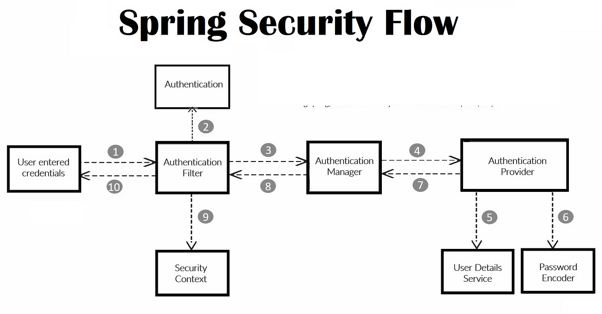
Spring Security Architecture

Slide 17
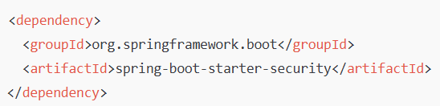
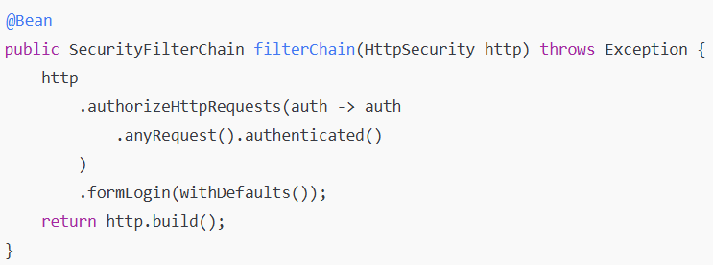
Setting Up Spring Security
1. Add Dependency:
2. Configure Security Filter Chain:

Slide 18
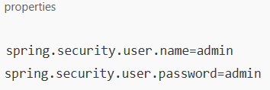
3. Default user credentials:

Slide 19
JWT Authentication & Authorization

Slide 20
Basics of JWT Authentication & Authorization
What is JWT?
JWT (JSON Web Token) is a compact, URL-safe means of representing claims between two parties.
It consists of three parts: Header, Payload, and Signature.
JWT – Get the token T1.
T1
/accounts

Slide 21
Basics of JWT Authentication & Authorization
Client sending “hello niloy” → Server
Bad guy changed “hello niloy” to “can you pay this online”
HMAC – Plain text + hash value of Plain text
“Hello “ + hashvalue (“Hello”)
Server
“Hello Niloy” + hashvalue (“Hello”) → Fail

Slide 22
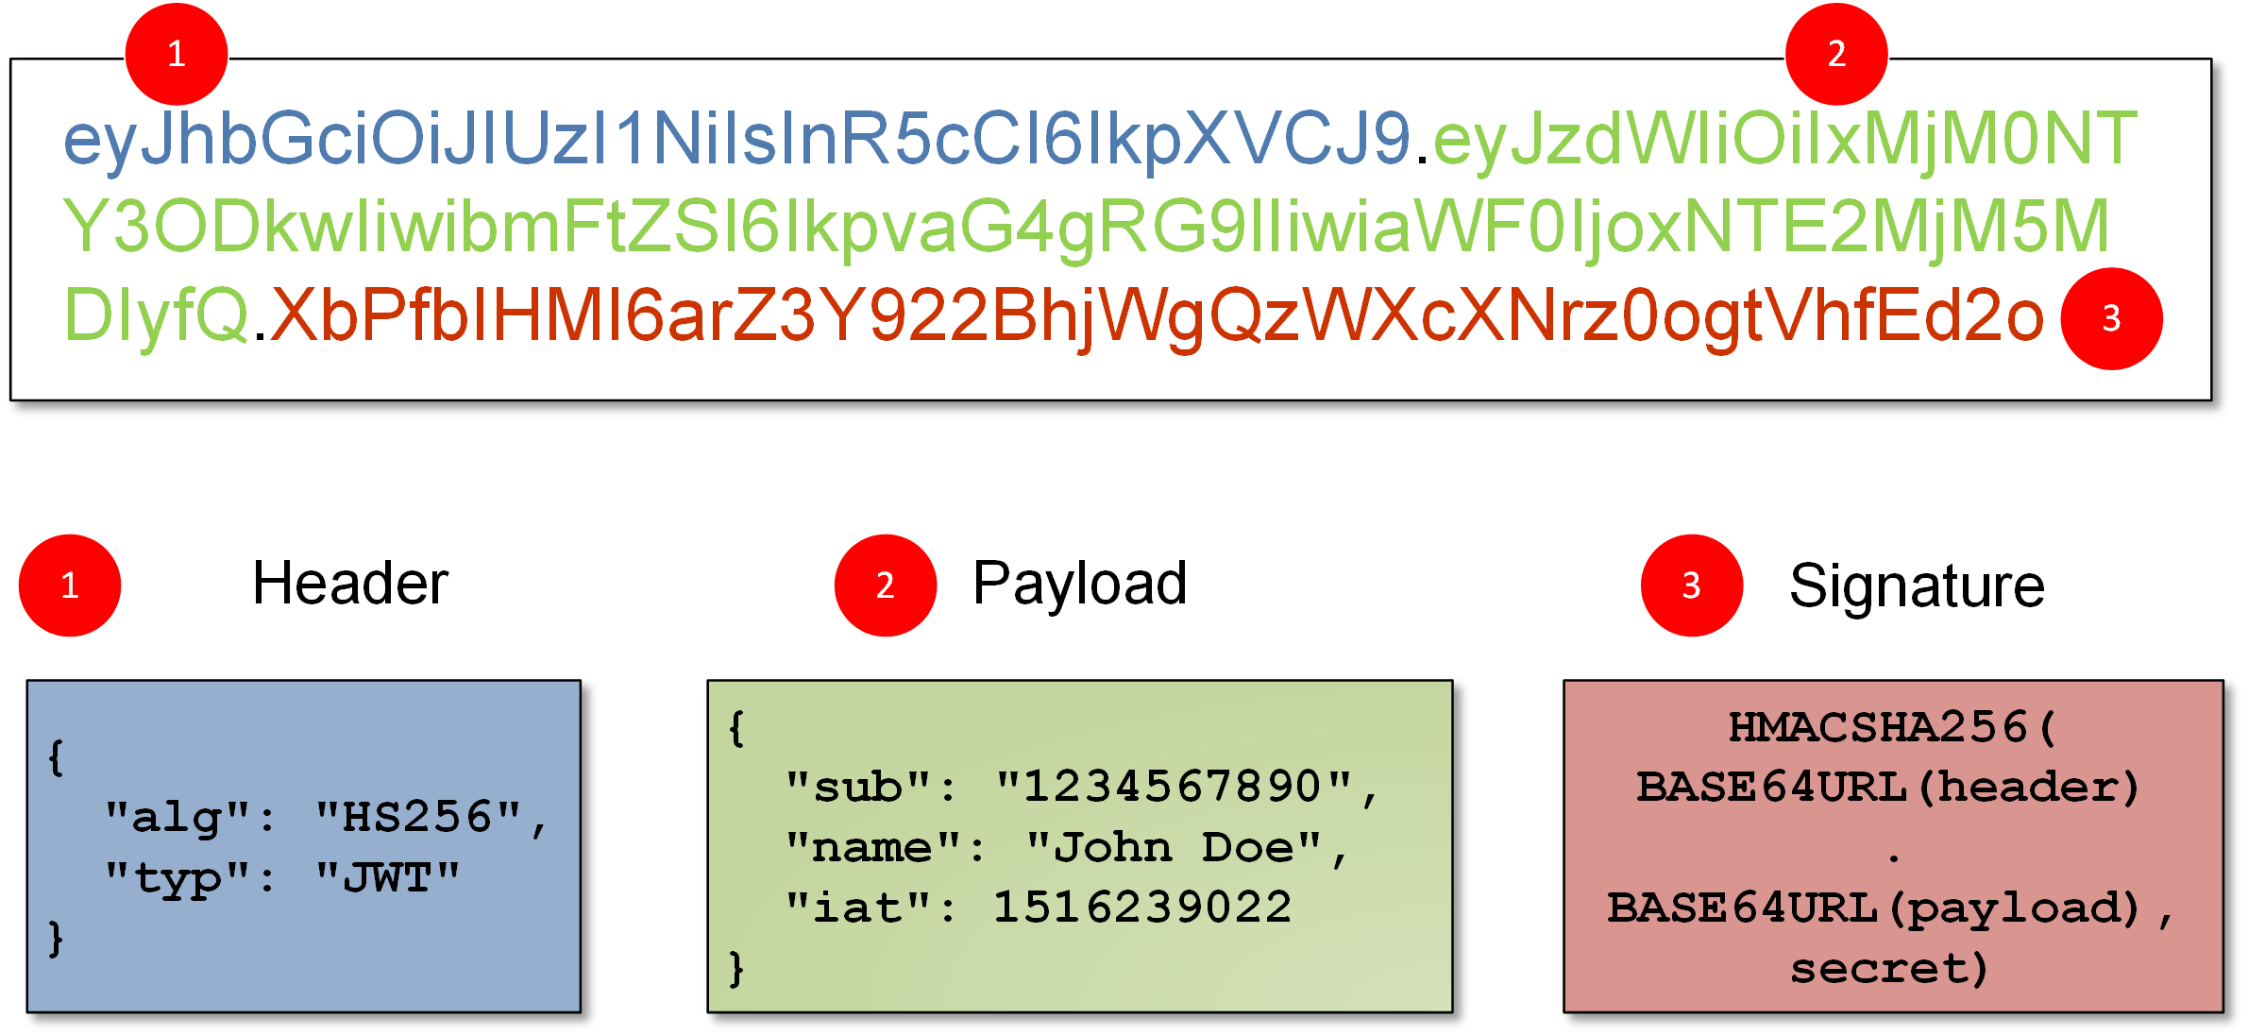
Basics of JWT Authentication & Authorization
What is JWT?
JWT (JSON Web Token) is a compact, URL-safe means of representing claims between two parties.
It consists of three parts: Header, Payload, and Signature.

Slide 23
Why use JWT?
Stateless and scalable
Ideal for microservices and REST APIs
Works well with OAuth2 and distributed systems
Structure: Header, Payload, Signature
Example JWT breakdown

Slide 24
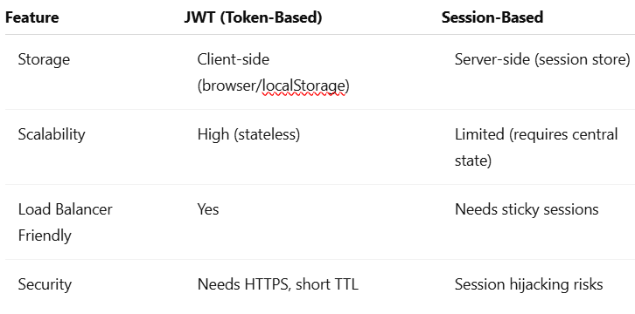
JWT vs Session-Based Auth

Slide 25
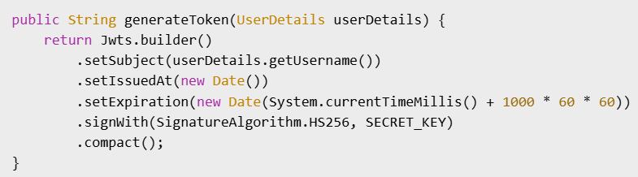
Implementing JWT with Spring Security
JWT Utility class (to generate and validate tokens)
Custom Authentication Filter (JwtAuthenticationFilter)
Security config to plug the filter into the filter chain

Slide 26
OAuth2 Flows and Roles

Slide 27
OAuth2 Overview
OAuth2 is a protocol for authorization, enabling third-party applications to obtain limited access to user resources without exposing credentials.
🔐 Key Concepts:
Authorization: Granting access rights to clients
Authentication: Verifying the user's identity (not originally OAuth2's job, but often combined with OpenID Connect)
👥 Actors in OAuth2 Flow:
Resource Owner – The user
Client – Application requesting access
Resource Server – Hosts the protected data
Authorization Server – Issues tokens

Slide 28
OAuth2 Grant Types
OAuth2 defines several grant types for different use cases:
Authorization Code (with PKCE) – Most secure; used by web & mobile apps
Client Credentials – Used for machine-to-machine communication
Resource Owner Password (deprecated) – Legacy flows; username/password sent directly
Implicit Flow (deprecated) – Was used by SPAs, now replaced by Authorization Code + PKCE

Slide 29
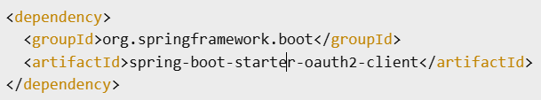
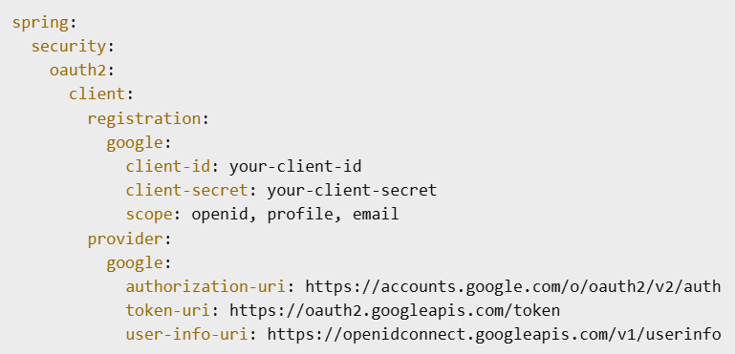
Integrating OAuth2 with Spring Boot:

Slide 30
OpenID Connect with Identity Providers

Slide 31
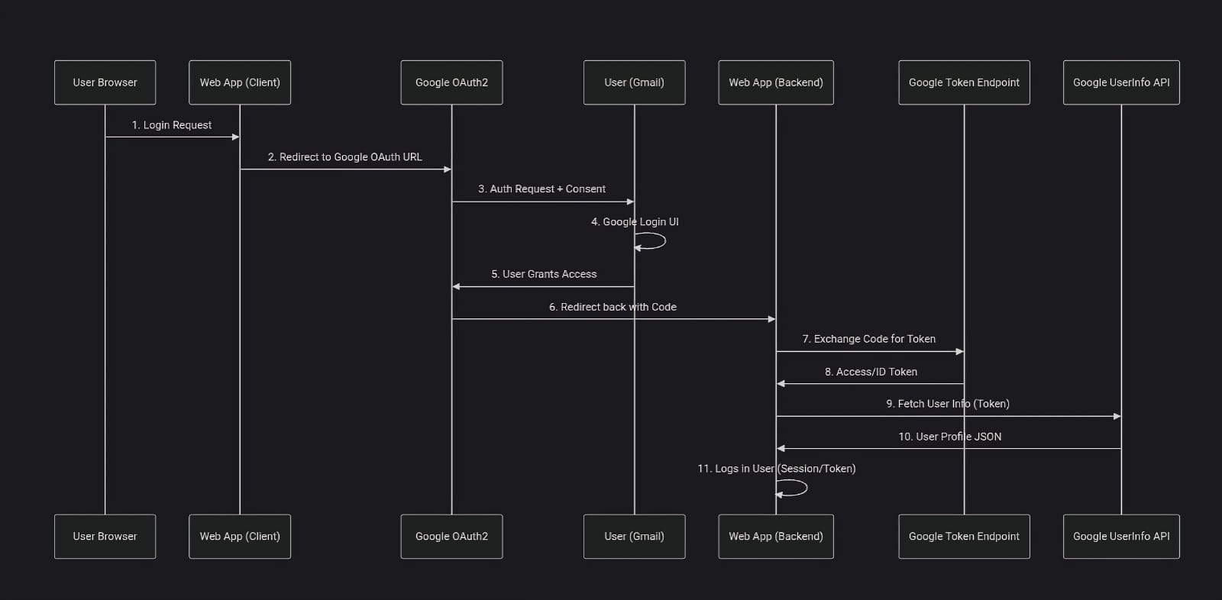
What is OpenID Connect (OIDC)?

Slide 32

What is OpenID Connect (OIDC)?
Oauth2
Register at google.
Clientid, secret.
This you have to put in application.yml
Clientid, secret
Google (ota)
makemytrip.com

Slide 33
What is OpenID Connect (OIDC)?
PING
gmail
gmeet
gdrive
Google sheets

Slide 34
What is OpenID Connect (OIDC)?
keycloak
gmail
gmeet
gdrive
Google sheets

Slide 35
What is OpenID Connect (OIDC)?
🔐 OpenID Connect (OIDC) is an identity layer built on top of OAuth2. It enables client applications to verify the identity of users based on the authentication performed by an authorization server.
Key Differences from OAuth2:
OAuth2 = Authorization only
OIDC = Authorization + Authentication
📄 Tokens in OIDC:
Access Token – Used to access resources (same as OAuth2)
ID Token – JWT that contains user identity information (e.g., name, email)

Slide 36
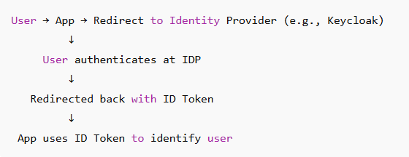
Integrating with Identity Providers
You can use popular Identity Providers (IdPs) like:
Keycloak (self-hosted)
Okta (cloud-based)
Auth0 (developer-focused SaaS)

Slide 37
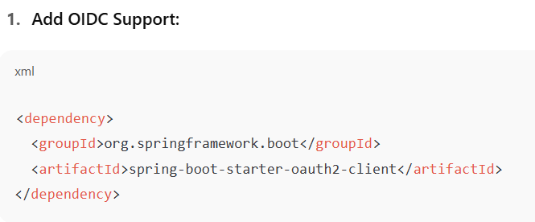
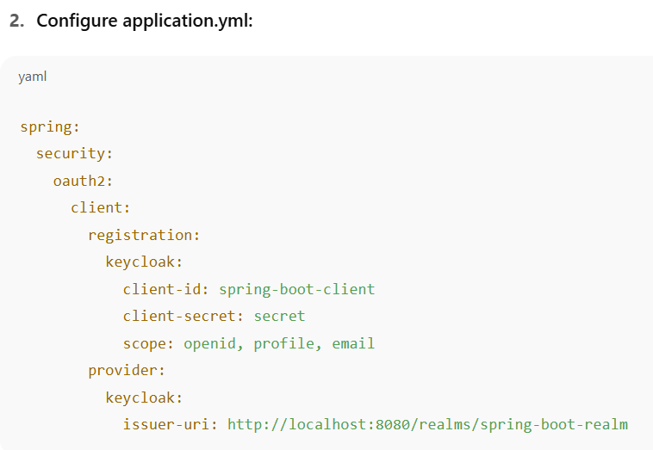
Spring Boot + OIDC Integration

Slide 38
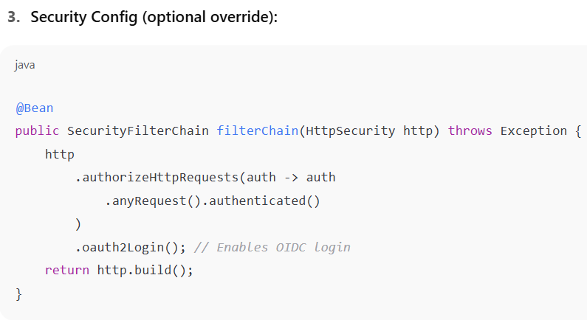

Slide 39
Best Practices in Microservices Testing

Slide 40
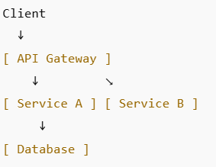
Common Security Challenges
Microservices bring flexibility, but also new attack surfaces.
🚨 Common Vulnerabilities:
❌ Insecure APIs (exposed endpoints)
🔄 No authentication between internal services
🕵️ Data leakage due to poor access controls
📡 Unencrypted communication between services
🔍 Missing audit logging

Slide 41
Best Practices
✅ Security Strategies:
HTTPS everywhere – Even internal services
Central Authentication – Use OAuth2 or OIDC through API Gateway
Token-based Access – Use JWTs for scalable stateless security
Role-based & Attribute-based Access Control (RBAC/ABAC)
Secure service-to-service calls – Mutual TLS (mTLS) or token relay
Enforce Token Expiry & Rotation
Zero Trust Model – Verify all interactions, no implicit trust

Slide 42
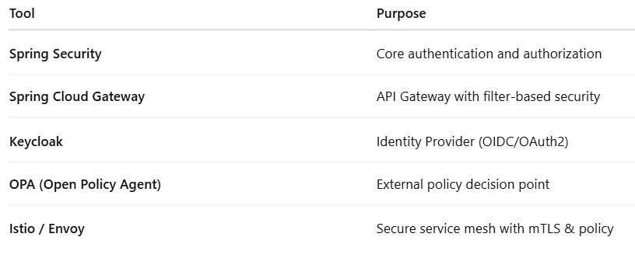
Tools and Libraries

Slide 43
Dockerize Spring Boot applications

Slide 44
Version management

Slide 45
Dev region
SIT region
UAT region
prod region
Cbanking1-.0.0-030825.jar
Cbanking1-.0.0-030825.jar
Cbanking1-.0.0-030825.jar
Cbanking1-.0.0-030825.jar
Docker (log files)
Docker
machine

Slide 46
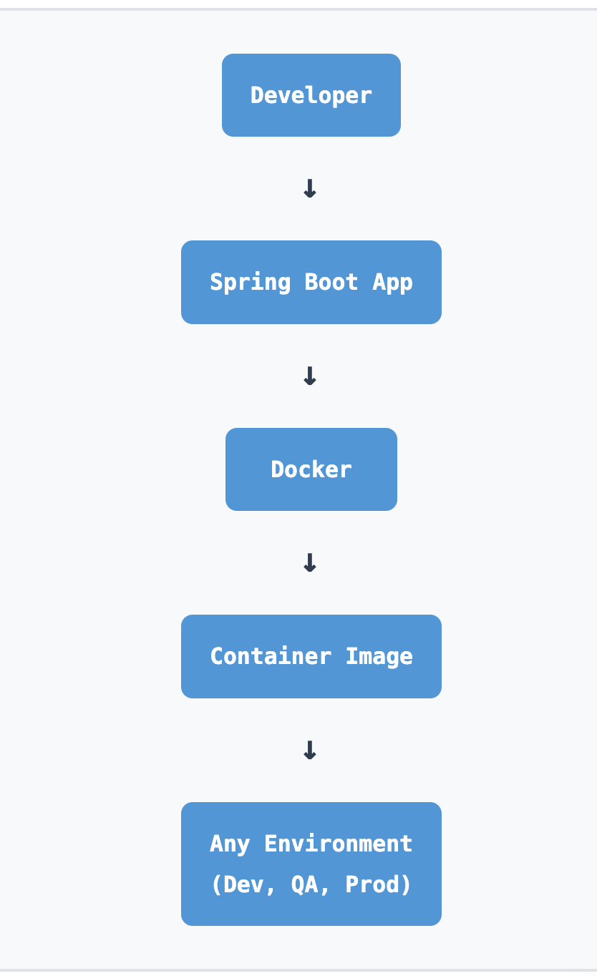
Why Dockerize Spring Boot Applications?
Introduction to Docker and Spring Boot
Portability across environments - Run consistently from development to production
Consistent builds - Eliminate "it works on my machine" issues
Lightweight runtime - Efficient resource utilization and faster deployments

Slide 47
Dockerizing a Spring Boot App
1.Build your Spring Boot JAR:
3. Build Docker Image:
./mvnw clean package
docker build -t myapp:latest .
2. Create Dockerfile:
FROM openjdk:17-jdk-slim
WORKDIR /app
COPY target/myapp.jar app.jar
ENTRYPOINT ["java", "-jar", "app.jar"]
4. Run the Container:
docker run -p 8080:8080 myapp:latest

Slide 48
Architecture & Workflow Diagram
Architecture: Spring Boot in a Containerized Workflow
Developer builds JAR using Maven
Docker builds an image with app code and base JDK
Image pushed to container registry (e.g., Docker Hub, AWS ECR)
Container deployed to environments (Dev/QA/Prod) via Docker or Kubernetes
[Developer] → [Spring Boot App] → [Docker Image] → [Registry]
↓ ↓
[Docker Build] [Dev/Test/Prod Environment]
↓ ↓
[Local Testing] [Orchestration (K8s/Docker Swarm)]

Slide 49
Best Practices & Optimization
Use multi-stage builds to reduce image size and improve security
Base image selection: Use openjdk:<version>-slim or distroless for minimal footprint
Externalize configuration using environment variables or mounted config files
Tag images with meaningful names (e.g., myapp:1.0.0, myapp:latest)
Use .dockerignore to optimize build context and reduce image size
Ensure containers are stateless:
Log to stdout for container orchestration
Use volumes for persistent data
Store configuration externally

Slide 50
Docker Compose for multi-container apps

Slide 51
Introduction to Docker Compose
What is Docker Compose?
Tool for defining and managing multi-container Docker applications
Uses a docker-compose.yml file to configure:
  Services (containers)
  Networks
  Volumes
Simplifies orchestration of app dependencies (e.g., DB, API, frontend)
Example Use Cases:
Spring Boot app + MySQL + Redis
React frontend + Node.js backend + MongoDB
Microservices architecture with shared databases
[docker-compose.yml] → [Docker Compose CLI] → [Multiple Containers Started Together]

Slide 52
“docker-compose.yml” File Structure
Anatomy of a docker-compose.yml File
Example for Spring Boot + MySQL setup:
version: '3.8'
services:
app:
build: .
ports:
- "8080:8080"
depends_on:
- db
db:
image: mysql:8
environment:
MYSQL_ROOT_PASSWORD: root
MYSQL_DATABASE: appdb
Key Concepts:
Services - defines the application components
Depends_on - defines container startup order
Volumes, Networks - can be added for persistence and communication
Environment - sets container environment variables

Slide 53
Docker Compose Workflow & Architecture
Docker Compose in Action: Workflow Overview
Developer defines containers in docker-compose.yml
Single command starts all services: docker-compose up -d
Docker Compose handles:
Network creation
Volume mounting
Dependency startup
Ideal for development, testing, CI/CD setups
[ docker-compose.yml ]
↓
[ Docker Compose CLI ]
↓
[ App Container ] ←→ [ DB Container ] ←→ [ Cache Container ]
↓
Shared Network / Volumes
Benefits:
Single command deployment, consistent environments, simplified local development
Key Commands Reference:
docker-compose up -d # Start services in background
docker-compose down # Stop and remove containers
docker-compose logs # View service logs
docker-compose ps # List running services

Slide 54
Kubernetes basics
(pods, services, deployments)

Slide 55
Introduction to Kubernetes Core Concepts
What is Kubernetes?
Open-source platform for automating container orchestration
Manages deployment, scaling, and operations of application containers
Ideal for microservices and distributed systems
Key Components:
Pod - Smallest deployable unit (one or more containers)
Service - Exposes pods to internal/external traffic
Deployment - Manages rollout and scaling of pod
[Deployment] → [ReplicaSet] → [Pods] → [Containers]
[Service] exposes Pods

Slide 56
Understanding Pods in Kubernetes
apiVersion: v1
kind: Pod
metadata:
name: myapp-pod
spec:
containers:
- name: app
image: myapp:latest
A Pod is a wrapper around one or more containers
Shared network namespace (localhost) and storage
Used to co-locate tightly coupled containers (e.g., app + sidecar)
[Pod] → contains [Container(s)] → shares IP & volume
Best Practice: Don't run multiple unrelated containers in a pod

Slide 57
Services and Networking
apiVersion: v1
kind: Service
metadata:
name: myapp-service
spec:
type: NodePort
selector:
app: myapp
ports:
- port: 80
targetPort: 8080
Exposing Pods with Kubernetes Services
Pods are ephemeral - their IPs change frequently
Service provides stable endpoint to access pods
Types of Services:
ClusterIP (default) - Internal access only
NodePort - Expose on static port on each node
LoadBalancer - Provision external load balancer (cloud)
[User] → [Service] → [Pod(s)]
(stable IP) (dynamic IPs)

Slide 58
Deployments – Managing at Scale
apiVersion: apps/v1
kind: Deployment
metadata:
name: myapp-deployment
spec:
replicas: 3
selector:
matchLabels:
app: myapp
template:
metadata:
labels:
app: myapp
spec:
containers:
- name: app
image: myapp:latest
[Deployment] → [ReplicaSet] → [Pod 1]
→ [Pod 2]
→ [Pod 3]
Rolling Update Process
Deployments for Scaling and Rollouts
A Deployment manages pod replicas using ReplicaSets
Automates:
Scaling (horizontal)
Rolling updates
Rollbacks
Key Attributes:
Declarative (kubectl apply -f)
Self-healing (recreates failed pods)
Ideal for stateless services
Essential Commands:
kubectl apply -f deployment.yaml # Deploy
kubectl scale deployment myapp --replicas=5 # Scale
kubectl rollout status deployment/myapp # Check status

Slide 59
Kubernetes Cluster

Slide 60
Introduction to Kubernetes Cluster
A Kubernetes cluster is a set of nodes used to run containerized applications
Nodes can be physical or virtual machines
Cluster abstracts the infrastructure, allowing for:
Auto-scaling - Dynamic resource allocation
Load balancing - Traffic distribution across nodes
Fault tolerance - Self-healing and high availability
Orchestrates applications across multiple machines seamlessly
[ Master Node ]
↓
[ Worker Node 1 ] [ Worker Node 2 ]
↓ ↓
[ Pod(s) ] [ Pod(s) ]
Key Benefit:
Single control point for managing distributed containerized workloads

Slide 61
Kubernetes Cluster Architecture
Master Node (Control Plane):
Kube-apiserver - Entry point for all commands (kubectl)
Etcd - Cluster state key-value store
Controller-manager - Manages cluster state
Scheduler - Assigns pods to nodes
Worker Node:
Kubelet - Communicates with control plane, runs containers
Kube-proxy - Manages networking for pods
Container runtime - E.g., containerd, Docker
[Control Plane]
┌────────────────────────────┐
│ API Server │ Scheduler │
│ Controller │ etcd │
└────────────────────────────┘
┌────────────┬────────────┐
│ Worker Node. │ Worker Nodem │
│ kubelet │ kubelet │
│ kube-proxy │ kube-proxy │
│ Pods │ Pods │
└────────────┴────────────┘

Slide 62
Cluster Communication Flow
Kubectl CLI talks to the API Server - All cluster interactions
Scheduler places pods on available worker nodes based on resources
Kubelet pulls container images and runs containers on worker nodes
Service discovery via internal DNS - Pods communicate by service names
Kube-proxy routes external/internal traffic to appropriate pods
[kubectl] → [API Server] → [Scheduler/Controller]
↓ ↓
[etcd] [Worker Node → Pod]
↑ ↓
[State Store] [Container Runtime]
Data Flow:
Commands → API → State Store → Worker Execution

Slide 63
Real-World Use Cases & Best Practices
Kubernetes Cluster in Practice:
Used by organizations for:
Microservice orchestration - Manage complex distributed applications
CI/CD pipeline environments - Automated testing and deployment
Auto-scaled cloud-native workloads - Dynamic resource management
Best Practices:
Use namespaces for resource isolation between teams/environments
Enable RBAC for access control and security
Monitor with Prometheus + Grafana for observability
Regularly back up etcd for disaster recovery
Enterprise Considerations:
Multi-zone deployment for high availability
Resource quotas to prevent resource exhaustion
Network policies for micro-segmentation security
Production Readiness:
Proper monitoring, backup strategies, and security controls are essential
Quick Reference Commands:
kubectl cluster-info # View cluster information
kubectl get nodes # List cluster nodes
kubectl get pods --all-namespaces # View all pods
kubectl describe node <node-name> # Node details

Slide 64
Helm, ConfigMaps, Secrets

Slide 65
Introduction to Helm
Helm is a Kubernetes package manager:
Simplifies deployment of applications using pre-configured Helm charts
Charts bundle Kubernetes YAMLs as reusable templates
Similar to apt or yum for K8s apps
Use Cases:
Deploying microservices with one command
Managing complex apps with dependencies
Promoting releases between environments
[Helm Chart] → [Templates] → [Rendered YAMLs] → [Kubernetes Cluster]

Slide 66
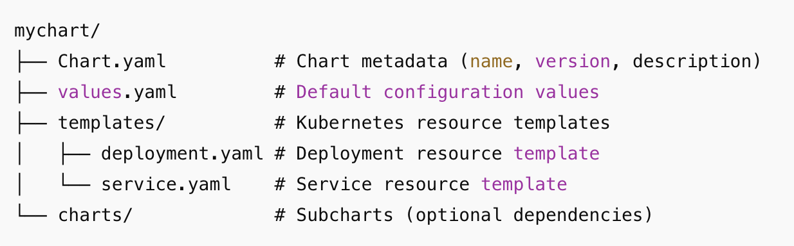
Helm Chart Structure
Helm Chart Directory Layout
Metadata about the chart - Chart.yaml
Default configuration values - values.yaml
Directory for YAML templates - templates/
Subcharts (dependencies) - charts/
Key Benefits:
Templating, versioning, dependency management, rollback capabilities

Slide 67
Helm Commands & Workflow
Using Helm – Commands and Workflow
Install a chart: helm install my-app ./mychart
Upgrade a release: helm upgrade my-app ./mychart
Uninstall: helm uninstall my-app
Template rendering: helm template ./mychart
Additional Commands:
Show installed releases - helm list
Rollback to previous version - helm rollback my-app 1
[values.yaml + templates/] → [helm install] → [Rendered Manifests] → [kubectl apply]

Slide 68
Introduction to ConfigMaps
What is a ConfigMap?
Stores non-sensitive configuration as key-value pairs
Separates app code from configuration
Mounted into pods as env vars or files
Use Cases:
App configs (e.g., DB URLs, feature flags)
Configuration files (e.g., nginx.conf, app.properties)
apiVersion: v1
kind: ConfigMap
metadata:
name: app-config
data:
LOG_LEVEL: DEBUG
FEATURE_X: enabled

Slide 69
Mounting ConfigMaps in Pods
Using ConfigMaps in Applications
Can be used via:
  Inject as environment variables - envFrom
  Volume mounts - Mount as files in filesystem
Updates automatically reflected (if watched by app)
Example - Environment Variables:
envFrom:
- configMapRef:
name: app-config
Example - Volume Mount:
[ConfigMap] → [Pod] → [Injected as ENV or Mounted File]
volumes:
- name: config-volume
configMap:
name: app-config

Slide 70
Kubernetes Secrets Overview
What is a Secret?
Stores sensitive data (e.g., passwords, tokens, certs)
Base64 encoded (not encrypted by default)
Can be mounted like ConfigMaps
Use Cases:
API keys
DB credentials
TLS certificates
Example YAML:
apiVersion: v1
kind: Secret
metadata:
name: db-secret
type: Opaque
data:
username: YWRtaW4=
password: MWYyZDFlMmU2N2Rm

Slide 71
Best Practices for Secrets
Using Secrets Securely
Avoid hardcoding secrets in YAML files
Use external secret managers (e.g., HashiCorp Vault, AWS Secrets Manager)
Enable encryption at rest in Kubernetes
Use RBAC to control secret access
Rotate secrets regularly
Security Considerations:
Secrets are only Base64 encoded, not encrypted
Consider using sealed-secrets or external secret operators
Limit secret access to necessary pods only
[Secret] → [Mounted into Pod]
↓
Used securely by application

Slide 72
Helm + ConfigMaps + Secrets Workflow
Key Takeaways:
Helm manages application deployment and versioning
ConfigMaps handle non-sensitive configuration
Secrets manage sensitive data with proper security practices
Combine all three for production-ready Kubernetes applications
Best Practice Integration:
# In Helm values.yaml
config:
logLevel: DEBUG
secrets:
dbPassword: "{{ .Values.database.password }}"
Example YAML:
# Helm
helm install myapp ./chart --set config.env=prod
# ConfigMaps
kubectl create configmap app-config --from-file=config.yaml
# Secrets
kubectl create secret generic db-secret --from-literal=password=mysecret

Slide 73
Load balancing, health checks

Slide 74
Load Balancing in Kubernetes
What is Load Balancing?
Distributes incoming traffic across multiple pods or services
Ensures high availability and fault tolerance
Common in microservices and container orchestration
Types of Load Balancers:
Internal (ClusterIP) - pod-to-pod traffic within cluster
External (LoadBalancer / Ingress) - user-to-service traffic
Strategies: Round Robin, Least Connections, or weighted algorithms
Example:
A service with 3 backend pods receives traffic evenly distributed
[Client Requests]
↓
[Load Balancer]
[Pod1] [Pod2] [Pod3]
Automatic failover and improved application performance

Slide 75
Load Balancer Implementation
Load Balancing Mechanisms in Kubernetes
Kube-proxy handles internal service routing and traffic distribution
Ingress Controller manages HTTP(S) routing with advanced features
External Load Balancer provisioned automatically by cloud provider
Best Practices:
Use readiness probes to avoid sending traffic to unready pods
Combine with autoscaling for dynamic resilience
Configure appropriate session affinity when needed
Monitor traffic distribution for balanced load
apiVersion: v1
kind: Service
metadata:
name: webapp-service
spec:
type: LoadBalancer
selector:
app: webapp
ports:
- port: 80
targetPort: 8080

Slide 76
Health Checks in Kubernetes
Liveness and Readiness Probes
Liveness Probe - Checks if app is alive (restart if failed)
Readiness Probe - Checks if app is ready to receive traffic
Prevents routing to broken or initializing pods
livenessProbe:
httpGet:
path: /health
port: 8080
initialDelaySeconds: 5
periodSeconds: 10
readinessProbe:
httpGet:
path: /ready
port: 8080
initialDelaySeconds: 10
periodSeconds: 5
[Pod]
↓
[Liveness Probe] → Restart if failed
[Readiness Probe] → Include in Service if healthy

Slide 77
Health Check Strategies
Designing Effective Health Checks
Keep endpoints lightweight (/healthz, /ready) - avoid heavy operations
Ensure readiness probe checks dependencies (DB, cache, external APIs)
Avoid aggressive timeouts or short intervals to prevent false positives
Use different endpoints for liveness vs readiness when appropriate
Best Practices:
Startup probes for slow-starting containers
Monitor probe failures using kubectl describe pod or dashboards
Test health endpoints independently during development
Probe Types Available:
# HTTP GET probe
httpGet:
path: /health
port: 8080
# TCP Socket probe
tcpSocket:
port: 3306
# Command execution probe
exec:
command: ["cat", "/tmp/healthy"]

Slide 78
Traffic Flow with Health Checks:
Key Integration Points:
Load balancers respect readiness probes - unhealthy pods removed from rotation
Liveness probes ensure pod restart when application becomes unresponsive
Graceful shutdown with proper termination handling
[Load Balancer] → [Service] → [Healthy Pods Only]
↓
[Readiness Probe Filter]
Monitoring Commands:
kubectl get pods -o wide # Check pod status
kubectl describe service webapp-service # View service endpoints
kubectl logs pod-name # Check application logs

Slide 79
Deployment Pattern

Slide 80
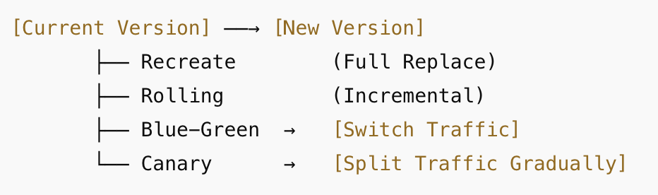
Overview of Common Deployment Patterns
Key Deployment Patterns in Modern Software Delivery
Deployment patterns define how new versions of software are released safely
Help ensure zero downtime, rollback capability, and gradual rollout
Popular Patterns:
1. Recreate - Stop old version, then deploy new one (downtime risk)
2. Rolling Update - Replace pods incrementally (minimal disruption)
3. Blue-Green Deployment:
Two environments: Blue (live) and Green (staging)
Switch traffic to Green after verification
4. Canary Deployment:
Release to small subset of users first
Gradually increase if stable

Slide 81
Choosing the Right Deployment Strategy
When to Use Which Deployment Pattern?
[Load Balancer]
[95% Current] [5% New Version]
↓ ↓
[Monitor Metrics & User Feedback]
↓
[Gradual Traffic Shift: 50% → 100%]
Pattern | Downtime | Rollback | Use Case
Recreate | Yes | Manual | Simple apps, dev environments
Rolling Update | No | Yes | Most microservices
Blue-Green | No | Instant | High-availability, critical apps
Canary | No | Granular | Risk-sensitive, user-feedback based
Best Practices:
Use health checks and monitoring with all patterns
Automate with CI/CD pipelines (e.g., ArgoCD, Jenkins, GitHub Actions)
Integrate metrics to support automated rollback decisions
Plan for database migrations and backward compatibility

Slide 82
Logging & monitoring in Kubernetes

Slide 83
Logging in Kubernetes
Logging in Kubernetes: Concepts and Tools
Kubernetes nodes write container logs to the node's filesystem (e.g., /var/log/containers/)
Kubectl logs <pod-name> - used for manual access to logs
Logs are ephemeral - lost if pods restart or nodes crash
Solution: Use centralized logging stack for persistence and analysis
Common Tools:
EFK stack (Elasticsearch, Fluentd, Kibana)
Loki + Promtail + Grafana - lightweight alternative
Fluent Bit as lightweight log forwarder
[Pod Logs] → [Fluentd / Promtail] → [Log Aggregator] → [Dashboard]
(Elasticsearch/Loki) (Kibana/Grafana)
Key Benefits: Centralized search, retention policies, structured logging, correlation across services

Slide 84
Monitoring Kubernetes: Metrics, Alerts & Dashboards
Monitoring Kubernetes: Metrics, Alerts & Dashboards
Monitoring helps observe pod health, node resource usage, and app performance
Expose metrics via Prometheus-compatible exporters
Alerting for critical metrics: CPU, memory, latency, availability
Toolchain:
Prometheus - Metrics collection and storage
Grafana - Visualization dashboards
Alertmanager - Rule-based alert notifications
Best Practices:
Set up both system-level and application-level monitoring
Use labels for log filtering and alert scoping
Store logs separately from metrics for optimal performance
Implement SLI/SLO-based alerting to reduce noise
[Node / Pod / App Metrics] → [Prometheus] → [Grafana Dashboards]
↓
[Alertmanager] → [Email / Slack / Webhooks]

